Slide 1
Subnetting & Supernetting
An organization (or an ISP) that is granted a range of addresses may divide the range into several subranges and assign each subrange to a subnetwork (or subnet).
In supernetting, an organization can combine several class C blocks to create a larger range of addresses.

Slide 2
Three-Level Addressing: Subnetting
An organization that was granted a block in class A or B needed to divide its large network into several subnetworks for better security and management.
The idea of splitting a block to smaller blocks is referred to as subnetting.
In subnetting, a network is divided into several smaller subnetworks (subnets) with each subnetwork having its own subnetwork address.

Slide 3
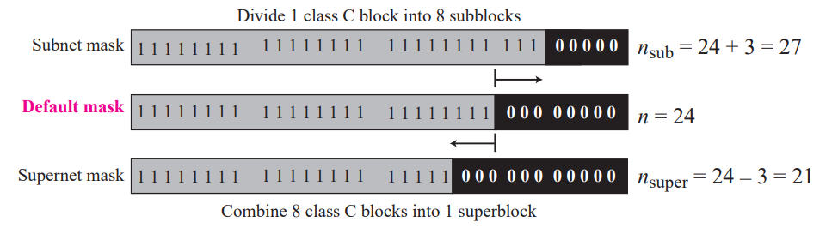

Slide 4
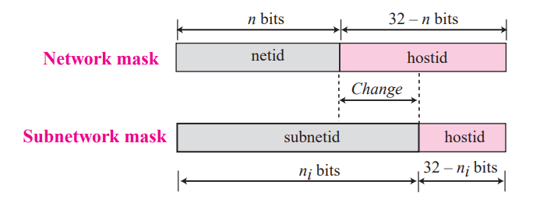
Network mask and subnetwork mask
Subnetting increases the length of the netid and decreases the length of hostid.

Slide 5
Classless addressing
Subnetting and supernetting in classful addressing did not really solve the address depletion problem and made the distribution of addresses and the routing process more difficult.
With the growth of the Internet, it was clear that a larger address space was needed as a long-term solution. The larger address space, however, requires that the length of IP addresses to be increased
The short-term solution still uses IPv4 addresses, but it is called classless addressing.

Slide 6
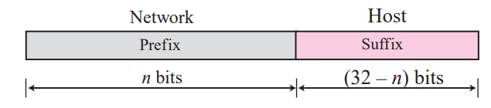
In classless addressing, the prefix defines the network and the suffix defines the host.

Slide 7
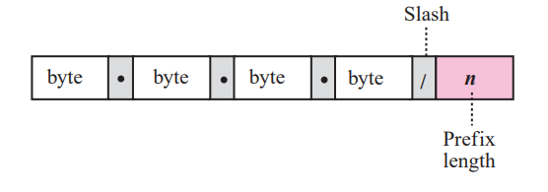
Slash notation
The slash notation is formally referred to as classless interdomain routing or CIDR notation.

Slide 8
Designing Subnets
1.The number of addresses in each subnetwork should be a power of
2. The prefix length for each subnetwork should be found using the following formula:
nsub = n + log2s (Or)
nsub = n + log2 (N/Nsub)
Total number of addresses granted to the organization is N
Prefix length is n
Assigned number of addresses to each subnetwork is Nsub
Prefix length for each subnetwork is nsub
Total number of subnetworks is s
3. The starting address in each subnetwork should be divisible by the number of addresses in that subnetwork. This can be achieved if we first assign addresses to larger networks.

Slide 9
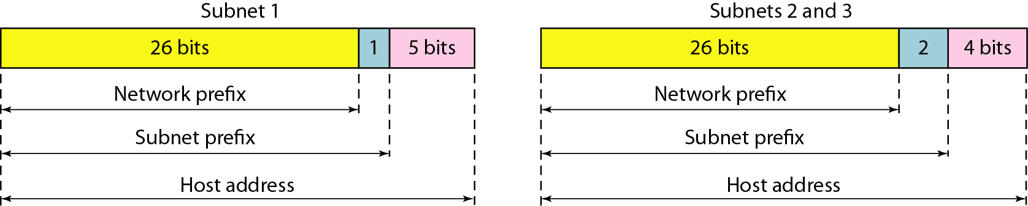
Three-level hierarchy in an IPv4 address

Slide 10
Extracting Block Information
The number of addresses in the block can be found as: N = 2^{32−n}
n is the prefix length and N is the number of addresses in the block.
First address = (any address) AND (network mask)
Last address = (any address) OR [NOT (network mask)]

Slide 11
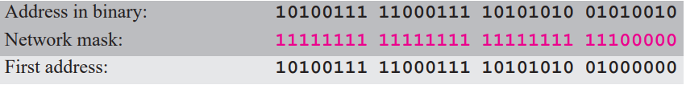
One of the addresses in a block is 167.199.170.82/27. Find the number of addresses in the network, the first address, and the last address. The number of addresses in the network is = 2^{32-n} = 2³²⁻²⁷ = 2⁵ = 32. We use the AND operation to find the first address (network address).The first address is 167.199.170.64/27.

Slide 12
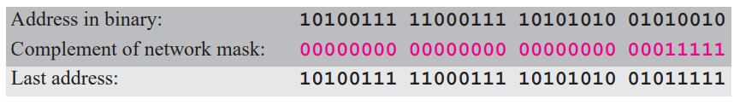
To find the last address, we first find the complement of the network mask and then OR it with the given address: The last address is 167.199.170.95/27.

Slide 13
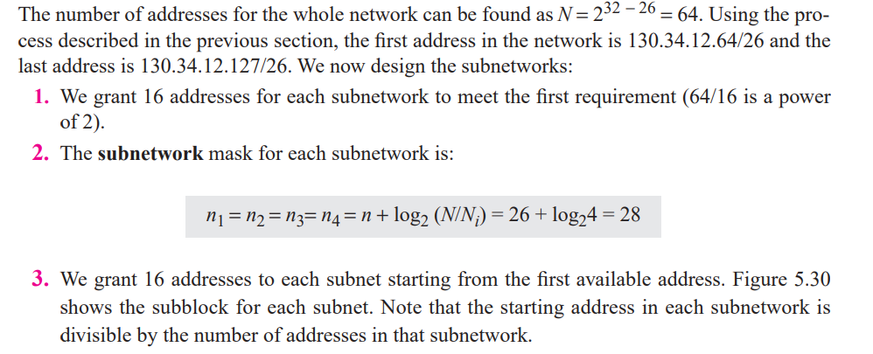
An organization is granted the block 130.34.12.64/26. The organization needs four subnetworks, each with an equal number of hosts. Design the subnetworks and find the information about each network.

Slide 14
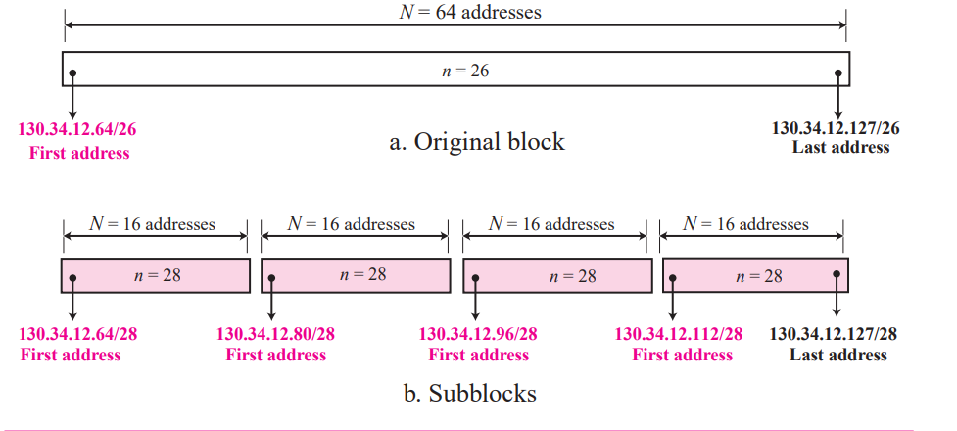

Slide 15
Example
An ISP is granted a block of addresses starting with 190.100.0.0/16 (65,536 addresses). The ISP needs to distribute these addresses to three groups of customers as follows:
a. The first group has 64 customers; each needs 256 addresses.
b. The second group has 128 customers; each needs 128 addresses.
c. The third group has 128 customers; each needs 64 addresses.
Design the subblocks and find out how many addresses are still available after these allocations.

Slide 16
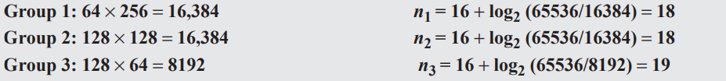
solve the problem in two steps.
In the first step, we allocate a subblock of addresses to each group.
The total number of addresses allocated to each group and the prefix length for each subblock can found as

Slide 17
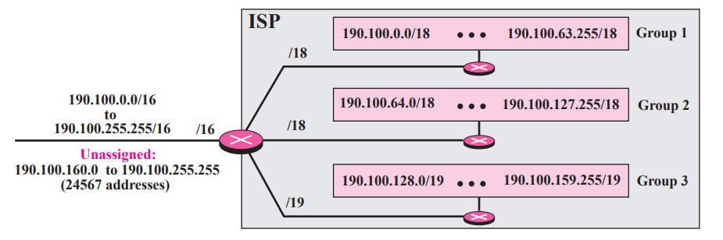
Design for the first hierarchical level

Slide 18
Second level of the hierarchy
The prefix length changes for the networks in each group depending on the number of addresses used in each network.

Slide 19
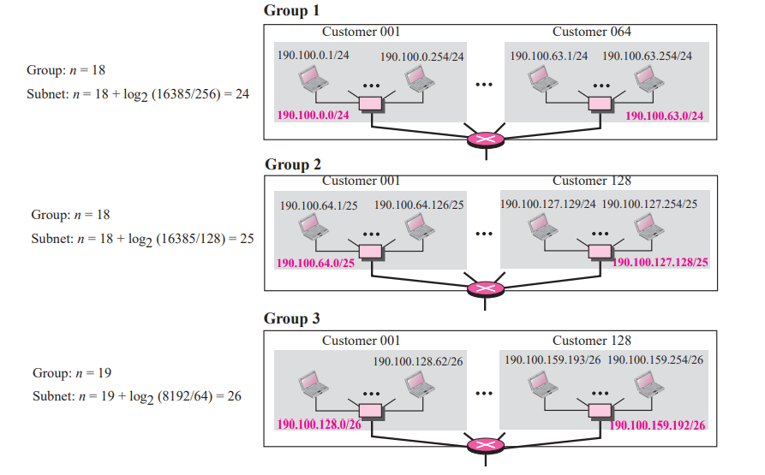

Slide 20
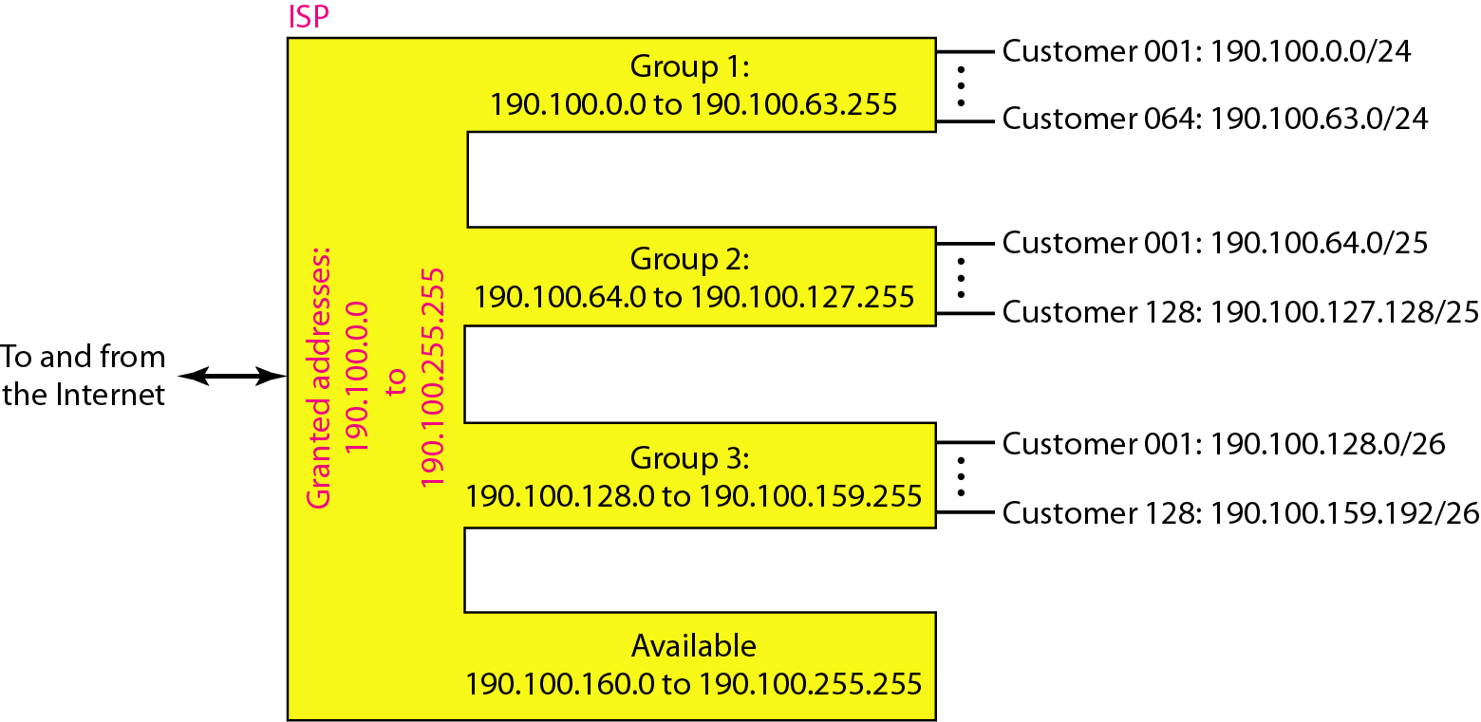
Address allocation and distribution by an ISP

Slide 21
Given IP Address 199.112.73.54, subnet mask 255.255.255.224, find the following: 1. Find the number of subnets 2.No of hosts per subnet 3. 1sthost of 3rd subnet 4. 6thhost of 4th subnet 5. 2ndhost of last subnet 6.Directed broadcast of 2nd subnet

Slide 22
An organization is granted a block of addresses with the beginning address 14.24.74.0/24. The organization needs to have 3 subblocks of addresses to use in its three subnets as shown below:
❑ One subblock of 120 addresses.
❑ One subblock of 60 addresses.
❑ One subblock of 10 addresses.
There are 2 ³²⁻²⁴ = 256 addresses in this block. The first address is 14.24.74.0/24; the last address is 14.24.74.255/24.

Slide 23
One subblock of 120 addresses.
The number of addresses in the first subblock is not a power of 2. We allocate 128 addresses.
The subnet mask for this subnet can be found as n1 = 24 + log2 (256/128) = 25.
The first address in this block is 14.24.74.0/25
The last address is 14.24.74.127/25

Slide 24
One subblock of 60 addresses.
The number of addresses in the second subblock is not a power of 2 either. We allocate 64 addresses.
The subnet mask for this subnet can be found as n1 = 24 + log2 (256/64) = 26.
The first address in this block is 14.24.74.128/26;
the last address is 14.24.74.191/26.

Slide 25
One subblock of 10 addresses.
The number of addresses in the third subblock is not a power of 2 either. We allocate 16 addresses.
The subnet mask for this subnet can be found as n1 = 24 + log2 (256/16) = 28.
The first address in this block is 14.24.74.192/28;
The last address is 14.24.74.207/28.

Slide 26
If we add all addresses in the previous subblocks, the result is 208 addresses.
48 addresses are left in reserve.
The first address in this range is 14.24.74.209. The last address is 14.24.74.255.

Slide 27
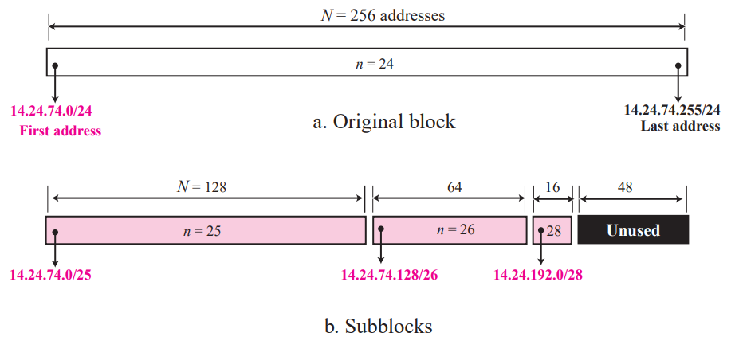

Slide 28
Network Address Translation (NAT)
ISP may not be able to grant the demand because the addresses before and after the range may have already been allocated to other networks.
A technology that can provide the mapping between the private and universal addresses

Slide 29
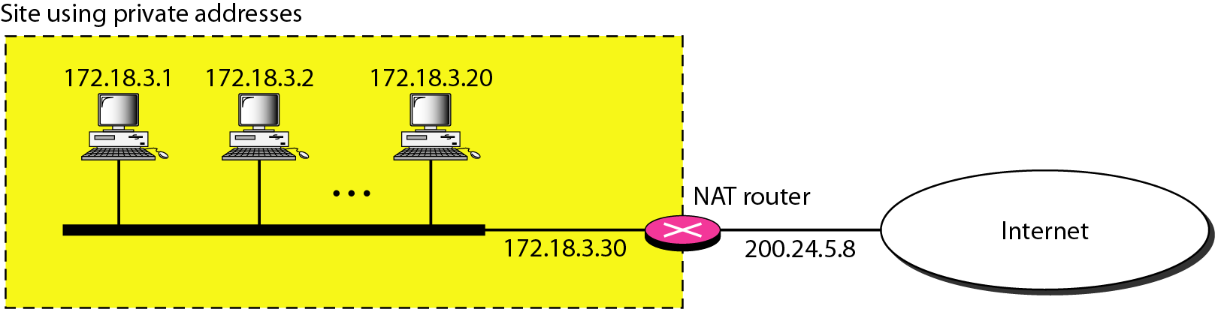
A NAT implementation

Slide 30
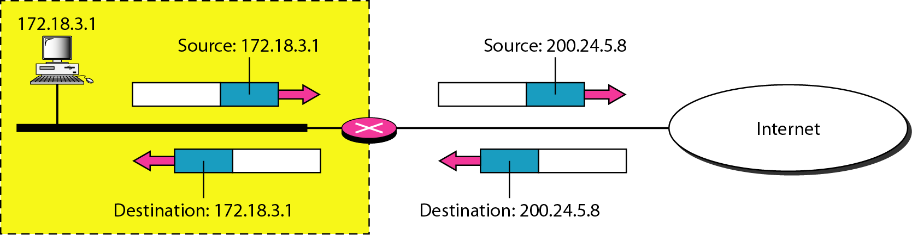
Addresses in a NAT

Slide 31
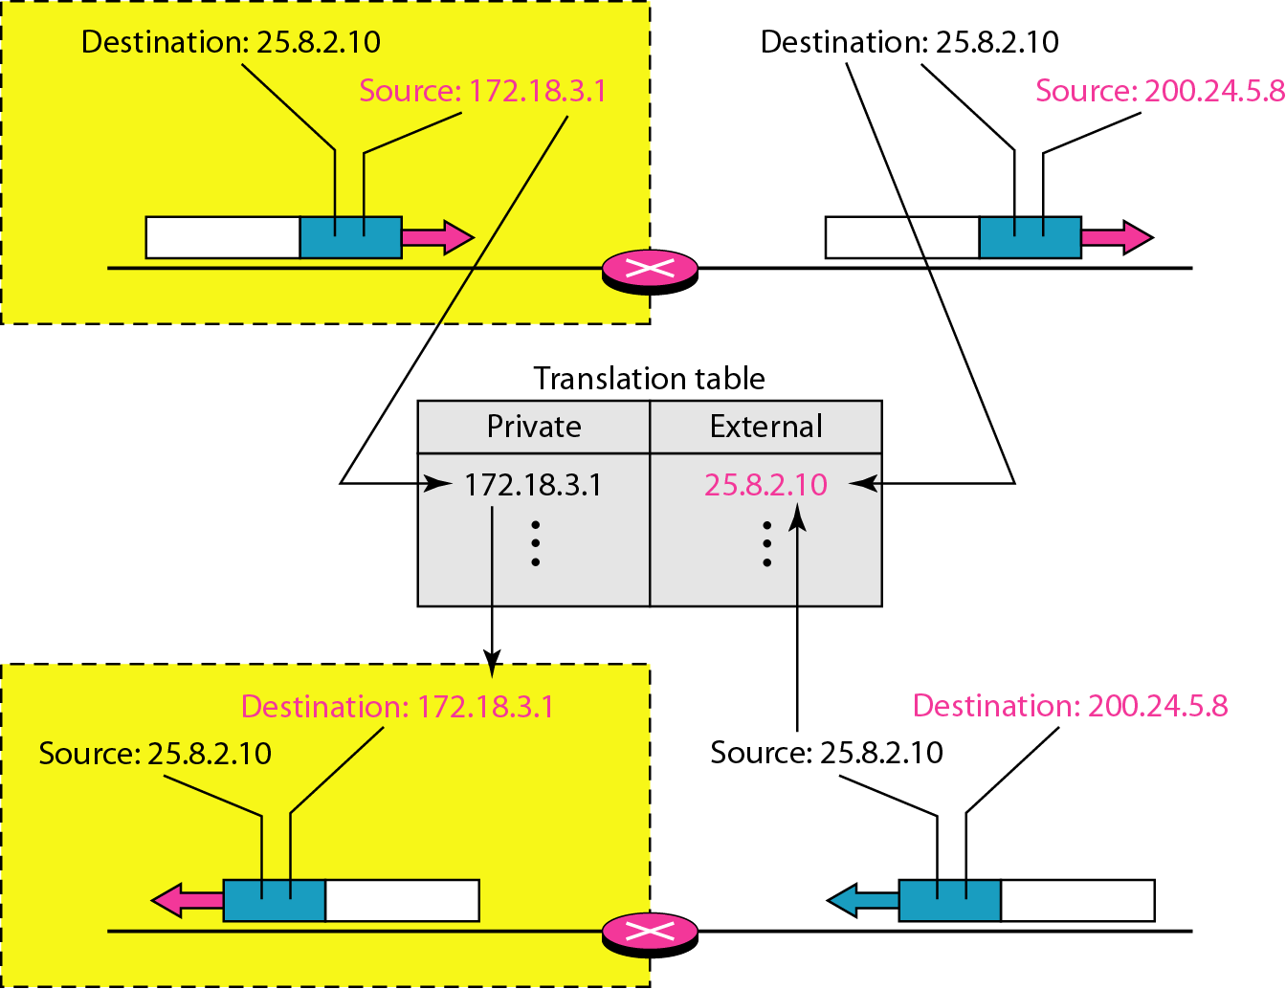
NAT address translation

Slide 32
Five-column translation table

Slide 33
Special addresses
some addresses were reserved for special purposes
All-Zeros Address The block 0.0.0.0/32, which contains only one single address, is reserved for communication when a host needs to send an IPv4 pack
All-Ones Address: Limited Broadcast Address
The block 255.255.255.255/32, which contains one single address, is reserved for limited broadcast address in the current network

Slide 34
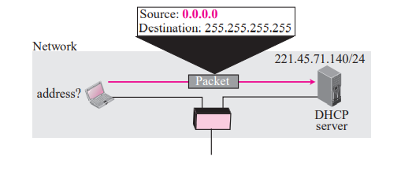
All-Zeros Address

Slide 35
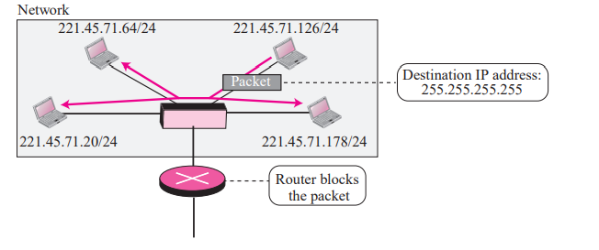
Limited Broadcast Address

Slide 36
Loopback Addresses
The block 127.0.0.0/8 is used for the loopback address
Its used to test the software on a machine. When this address is used, a packet never leaves the machine

Slide 37
